Slide 1
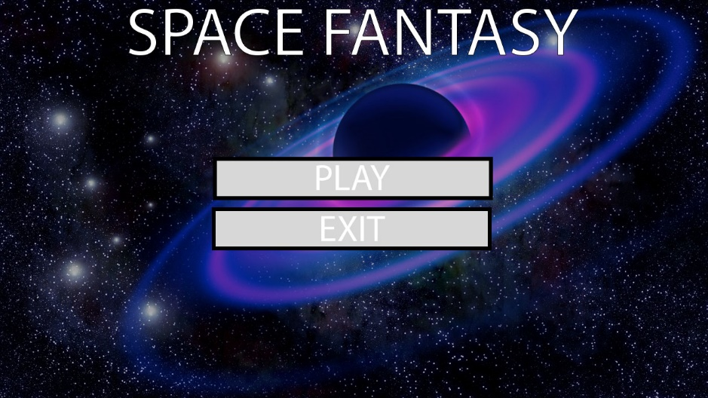
Space Fantasy
JOGY
JOGY STUDIOS Ltd.

Slide 2
User Features
Control a spaceship.
Travel between planets (Areas) to collect treasure used to level up
Different types of planets (Areas) offer different types of treasure
Defend themselves during travel between planets using ship’s weapons. Weapons damage ship’s force field according to strength, and ship is destroyed when force field is zero.
Enemy ships are handled as NPCs
Repair force fields with friendly ships.
Use weapons to attack enemy ships in areas.
User may choose weapon types between single target and scatter weapons.
Bomb that damages everyone, including self.
Damage types:
Generic
Shield damage only (EMP)
Shield piercing to health
Subsystem remover
Cargo remover
Healing
User may find other loot in areas or on ships
Can be sold
Count for points

Slide 3
Contributions
Jonathan
Object-oriented design
Olav
Group management
Gianmarco
User Interface
Yang
Testing

Slide 4
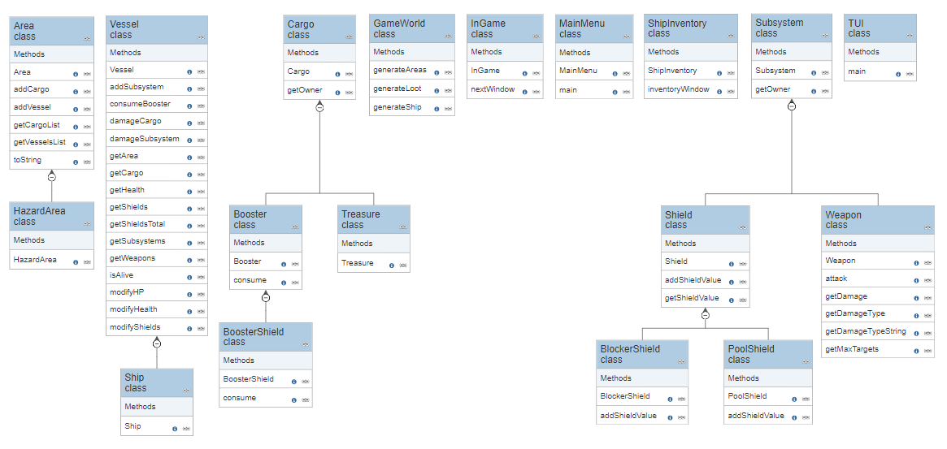
Class Diagram

Slide 5
Test Plan

Slide 6
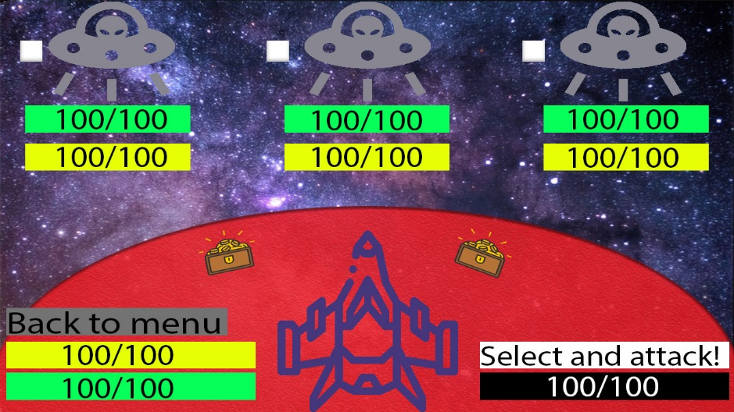
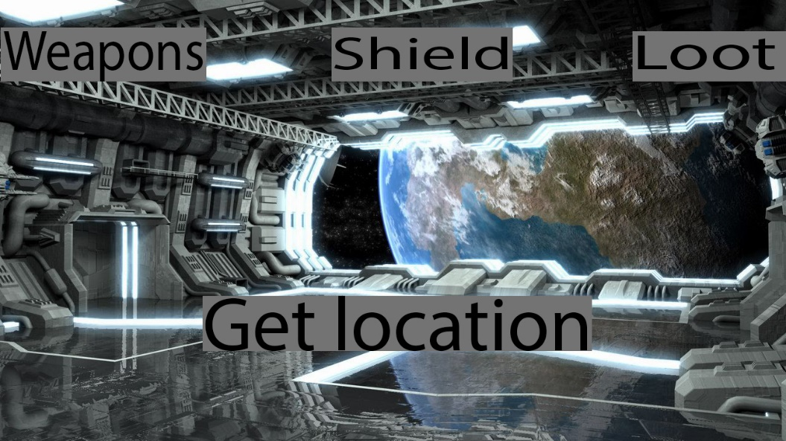
UI Design Photoshop

Slide 7
UI Design Java

Slide 8
Implementation

